Slide 1
Information Extraction from Micro-blogs Posted during
Disasters
Mrinal Aich, Shamik Kundu, Vaibhav Singh

Slide 2
Problem Statement description:
A large set of tweets posted during recent Nepal disaster event along with a set of topics (in TREC format) is given. Each ‘topic’ will identify a broad information need during a disaster.
Aim is to develop IR methodologies for extracting relevant tweets according to a given set of topics describing a generic information need during the disaster situation.

Slide 3
Drawback of other known approaches:
No labels & small data content: The data-set given doesn't contain any label and the text present in each tweet is very less to use any kind of supervised learning method for classification.
tf-idf scoring: The weighted score of words calculated cannot help in classifying in our case.
NLP based algorithms can’t be used since the sentence frames are not grammatically structured.

Slide 4
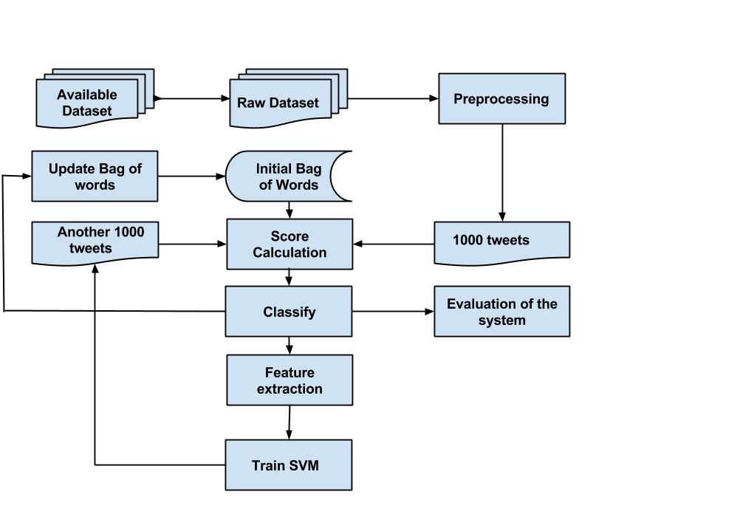
Framework of proposed model:

Slide 5
Choice of Algorithm for the problem:(1/3)
Raw tweets are extracted from the available json file.
Initial Bag of words is generated manually for 7 given classes having uni-grams and bi-grams.
Preprocessing:Normalized acronyms, removal of special symbols and stopwords.
1000 tweets are classified on the basis of these initial Bag of Words.
Set a particular threshold and if for a tweet the value of score of all the classes is below this threshold then mark the tweet as not useful.

Slide 6
Choice of Algorithm for the problem:(2/3)
6.Each of these classified tweets are then used for training SVM considering uni-grams as features. 7. Repeatedly, for another set of 1000 tweets (belonging to a diff. time interval) the Trained-SVM calculates probability of tweet belonging to each class.
8. Classification is done on the basis of Text Classification and SVM Classification, giving weightage to each across different iterations.
9. The Bag of Words are continuously getting updated (improved) based on the recently classified tweets.

Slide 7
Choice of Algorithm for the problem:(3/3)
10. Unuseful words are being removed from Bag of Words using an algorithm.
11. In next iteration, all classified tweets till that point are used for training SVM.
12. Since the Training data of SVM is increasing, the weight assigned to its score is also being increased across iterations.
13. Finally, after 5 iterations of training the SVM and updation of Bag of Words (increasing by 1000 tweets each time) all the remaining tweets are classified.

Slide 8
Formulas(1/2):
Updating bag of words:
Score calculation of a class:
Where α is weightage assigned to SVM score, less than 1.

Slide 9
Formulas(2/2):
3. Classification of tweets:
Where, threshold is an empirically calculated parameter.

Slide 10
Configurable Parameters of the System:
UnigramWeight = 1
BigramWeight = 3
AlphaFactor, α = 0.1
SVMTrainSetTweets = 1000
NeutralClassThresholdValue = 0.49 FrequentUnwantedWords = 125

Slide 11
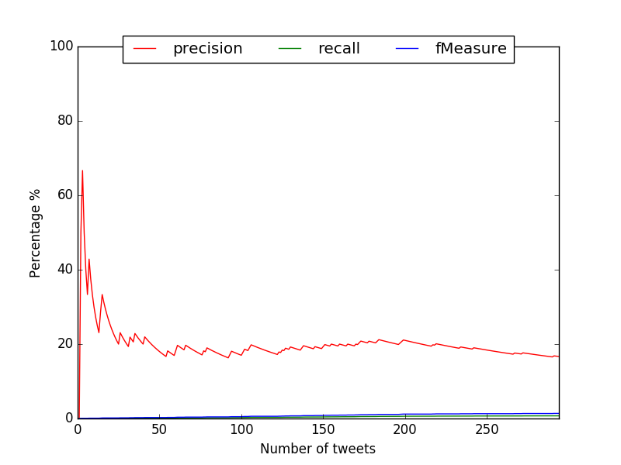
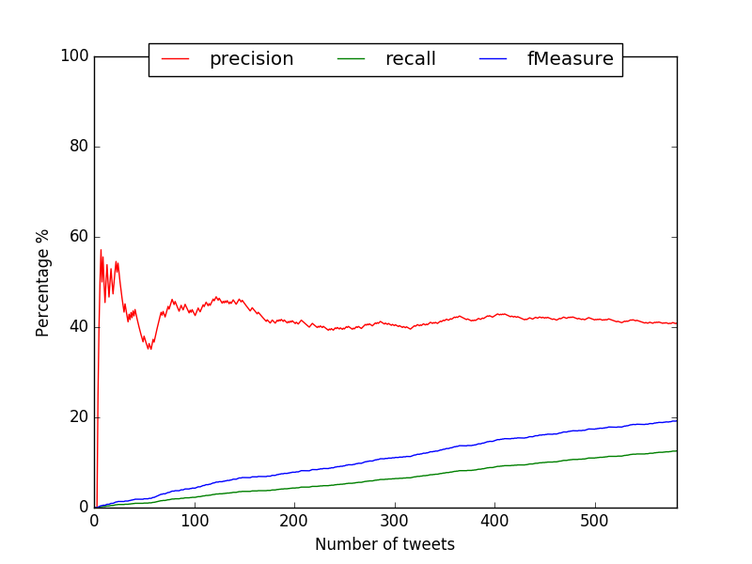
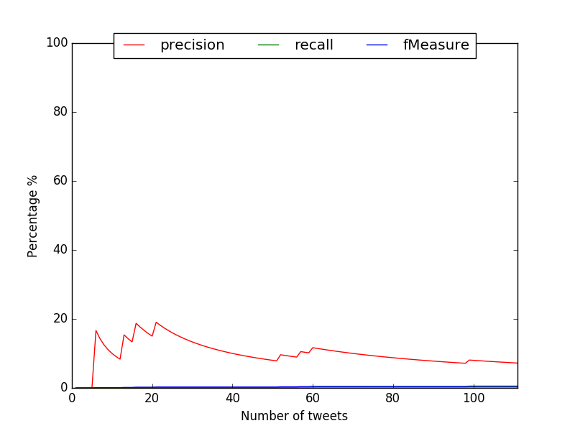
Results so far:(1/3)
Precision, Recall and F-measure Graphs:
Fig2 . Resources Required
Fig1. Resources Available Fig3. Medical Resources Required

Slide 12
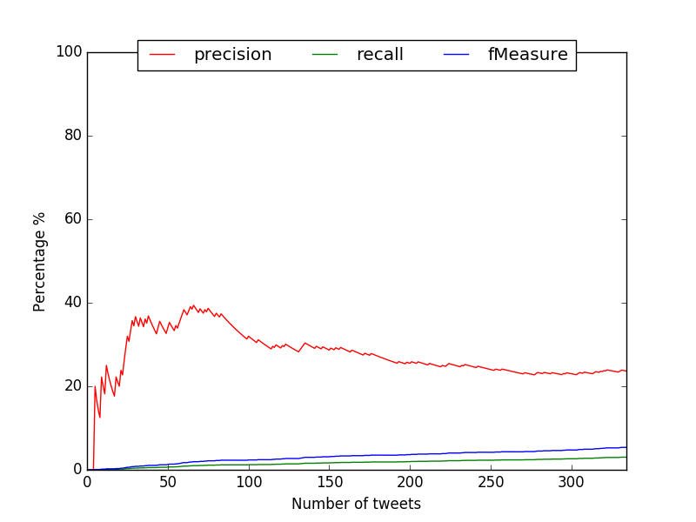
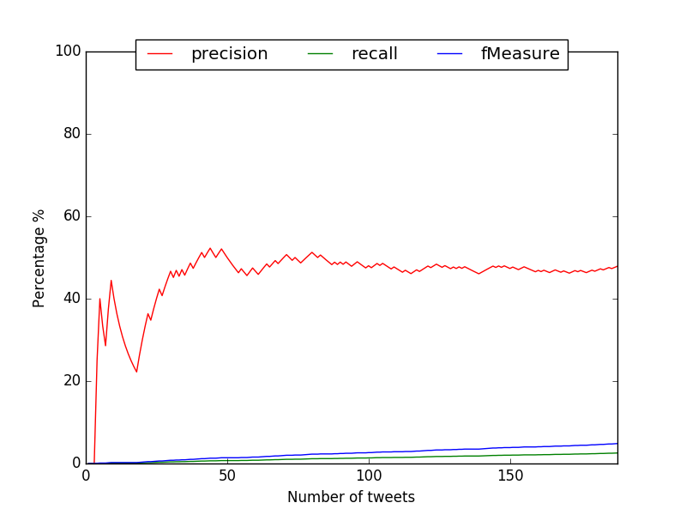
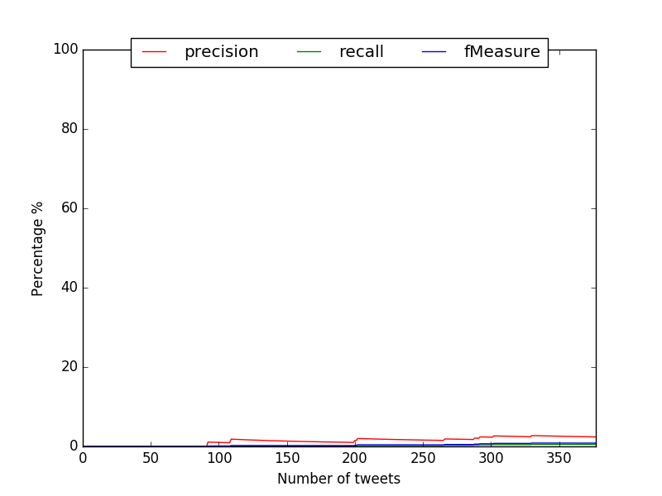
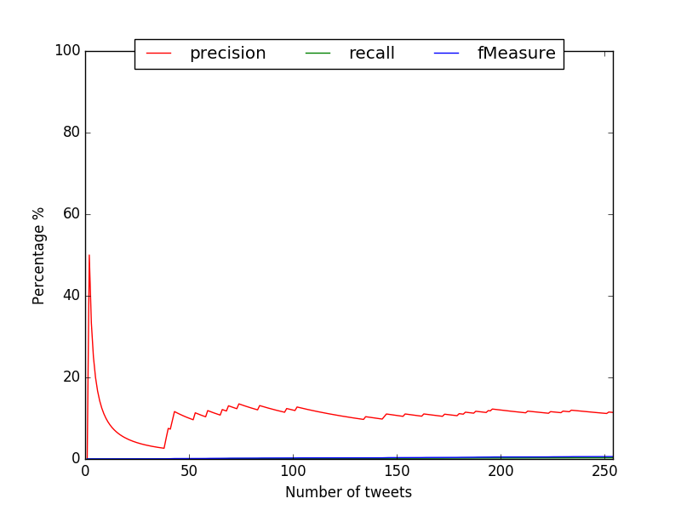
Results so far:(2/3)
Fig4. Medical Resources Available Fig5 Available/Requirement of rsc at specific Locations
Fig6 Activites of various NGOs Fig7 Infrastructure damage and restoration report

Slide 13
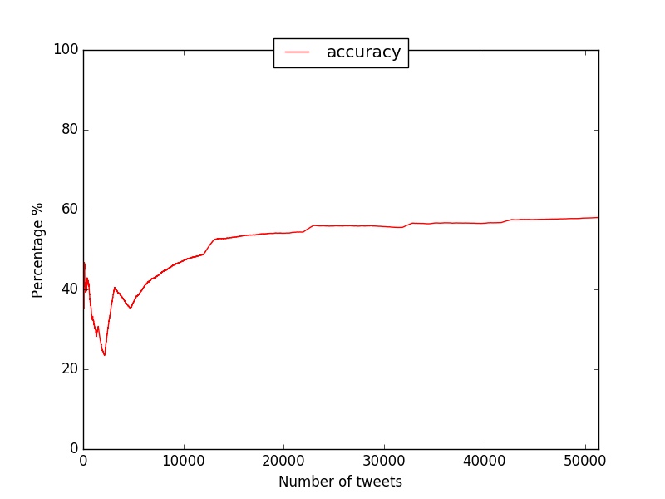
Results so far:(3/3)
Fig8 System Accuracy

Slide 14
Conclusion(1/2)
The System Accuracy is almost 60% mainly dominated by successful classification of Neutral tweets.
The precision in Classes Resources Req. and Available are good because of good set of initial Bag of words which included common words.
Class Avai./Req. of resources at spec. Locations also has a good precision as we considered all the villages and towns in Nepal in our bag of words.

Slide 15
Conclusion(2/2)
4. The Graph of class infrastructure damage restoration are not good as the Bag of words of this class is very closely related to the class resources required at specific location.
5. The graph of activities by NGOs is worst as making an exhaustive list of all the NGOs that are appearing in our dataset is practically not feasible.

Slide 16
Scope of Enhancement
Model accuracy is very dependent on the initial set of Bag of Words. Getting a better initial Bag of Words or making model less dependent on the same.
Better selection of parameters might result in better system accuracy.

Slide 17
THANK YOU

